Slide 1
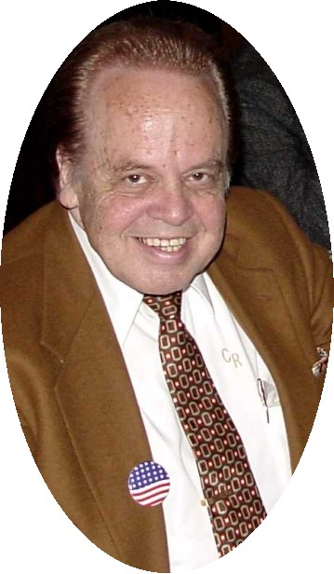
Clarence was an attorney and self-employed businessman. He was an avid coin and currency collector. He was a lifelong resident of New Orleans and a graduate of Jesuit High School, Loyola University, and Loyola University Law School.
Clarence joined the Crescent City Coin Club of New Orleans, Louisiana in June 1962. He served on committees for ANA conventions held in New Orleans in 1972 and 1981. Clarence was one of the most knowledgeable people in the world on United States currency, especially obsolete currency. He was renowned for his knowledge of Confederate and Louisiana bank notes. Clarence was a contributing author of the book, "US Obsolete Bank Notes, Volume 1, 1782-1866" by James Haxby.
Clarence Rareshide is survived by his wife, Elisabeth, nine children and fourteen grandchildren. Funeral mass was conducted on September 20, 2003 at St. John the Baptist Catholic Church. Clarence's brother, the Rev. Msgr. Lanaux Rareshide was the celebrant.

